Slide 1

The Coding Church
Final Project on Offensive speech automatic detection

Slide 2

Pipeline
3
1
Pickle
Life saver
Testing Classifiers
Brain consuming
Fetching Millions of Tweets
Time consuming
2
4
Flask Blog

Slide 3
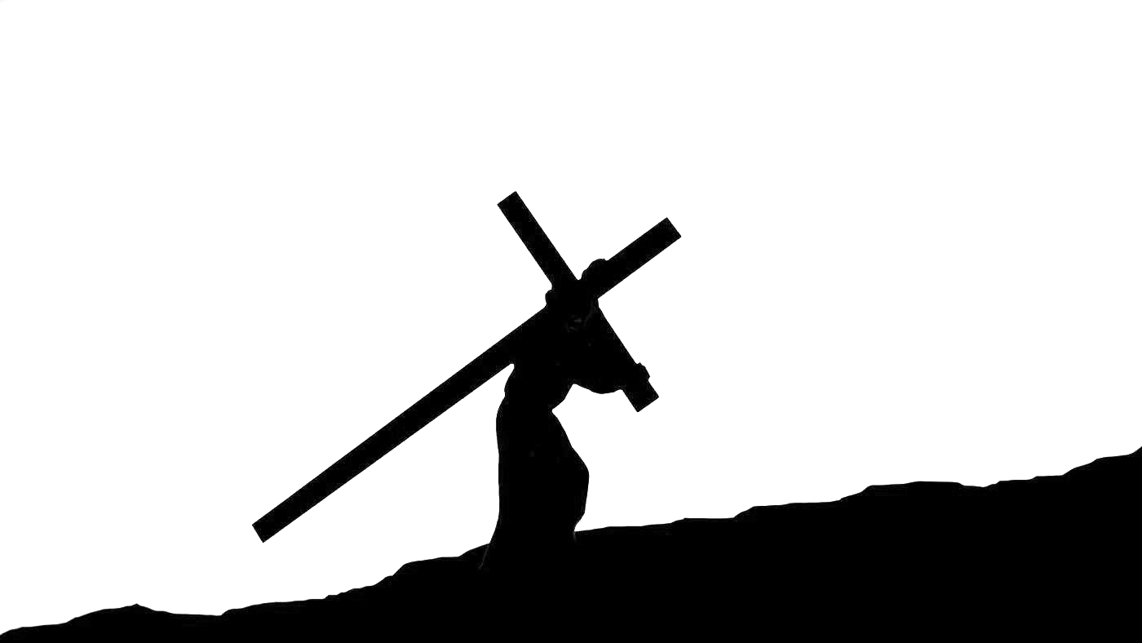
The Way of The Cross of our project
In the all process we fetched around 10 million tweets
Build and tested 9 different classifier and… the “Chosen One” is Gradient Boosting with 96% accuracy and 0.008 percent false positive
Built our Blog on Flask that contains our model + those features: Register, Login, Hash password, post and post updates, SQL Alchemy Database.

Slide 4
And now lets change water in wine
Our Flask has two main moderation features
Blog post moderation that blocks offensive content before posting
The admin can choose between 4 moderation level:
Hell level : very permissive
Permissive level :
Middle level
Church level : swearing is a sin
Vetting of user on registration : checking his all tweet history

Slide 5
Vetting function
As the vetting process includes:
Fetching tweets(10 mins)
All clean up(2 mins)
Vectorization(seconds)
Model predict(seconds)
We don't have time to do it live on our machine now. But basically the admin can choose that above x percent of offensiveness, the user is not allowed to register. Or he can choose that this particular user will post on church level, so that he s absolutely impossible for him to post offensive content.

Slide 6


Vetting : we fetched all tweets of...
Kevin hart:
16% offensive tweets
Donald Trump
2% offensive
tweets

Slide 7
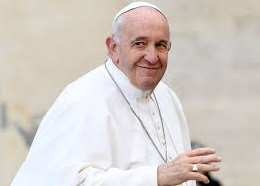
And the pope himself : @Pontifex
Pope Francis
0% offensive tweets

Slide 8
Improvement
The bag of word approach misses the context of the sentence.
Some words are allowed for some people, and not for others. It would be quite easy to code that some people are moderated on a specific model based on those characteristics, but is it ethical to discriminate ?
Exploring other NL packages.

Slide 9
Conclusion
“Natural language processing is a field that mixes Data Science and linguistic, sociology and even philosophy. It makes it an endlessly interesting subject.”

Slide 10
Thank you

